Slide 1
Background Check System

Slide 2
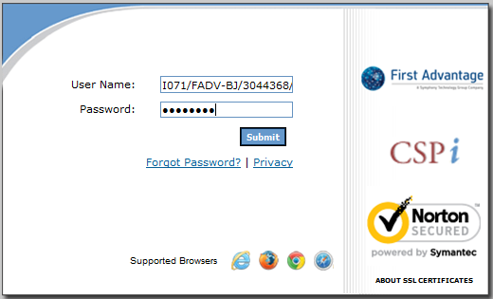
Please fill in user name and password from welcome email.

Slide 3
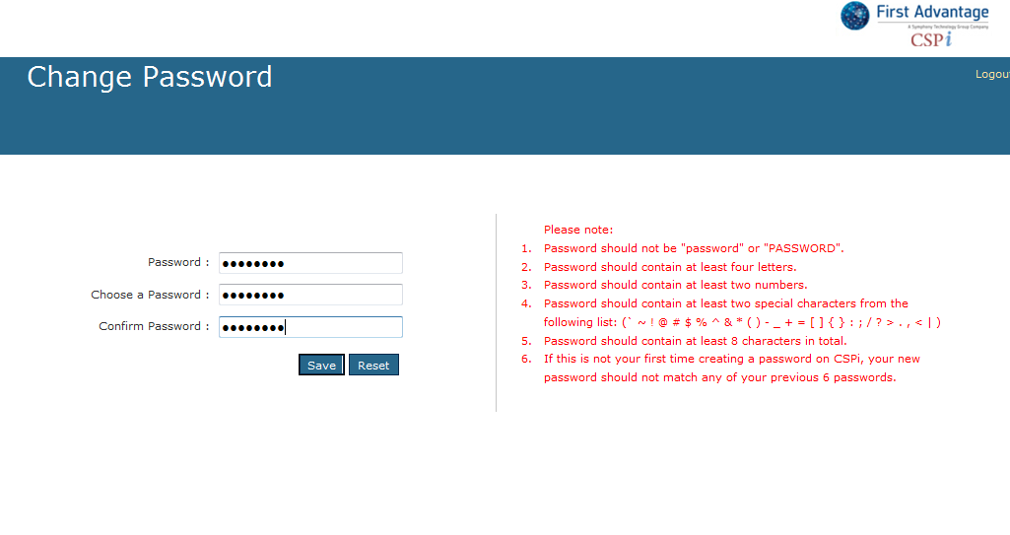

Slide 4
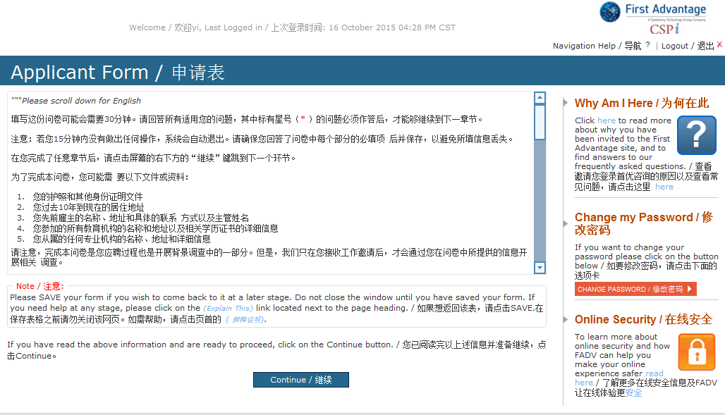
Click here to initiate

Slide 5
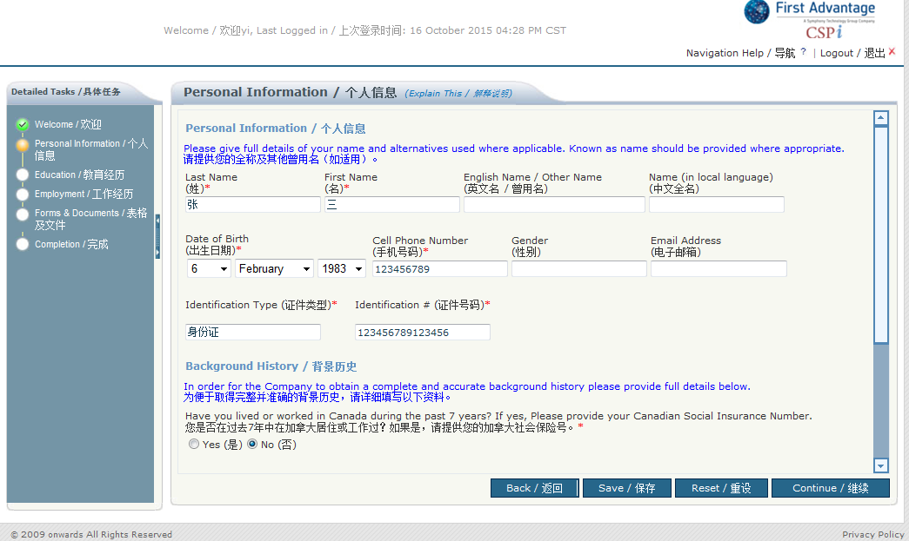
Please fill in your personal information, you can use the language both Chinese and English 中英文都可以
Once complete this part, please save first, then continue

Slide 6
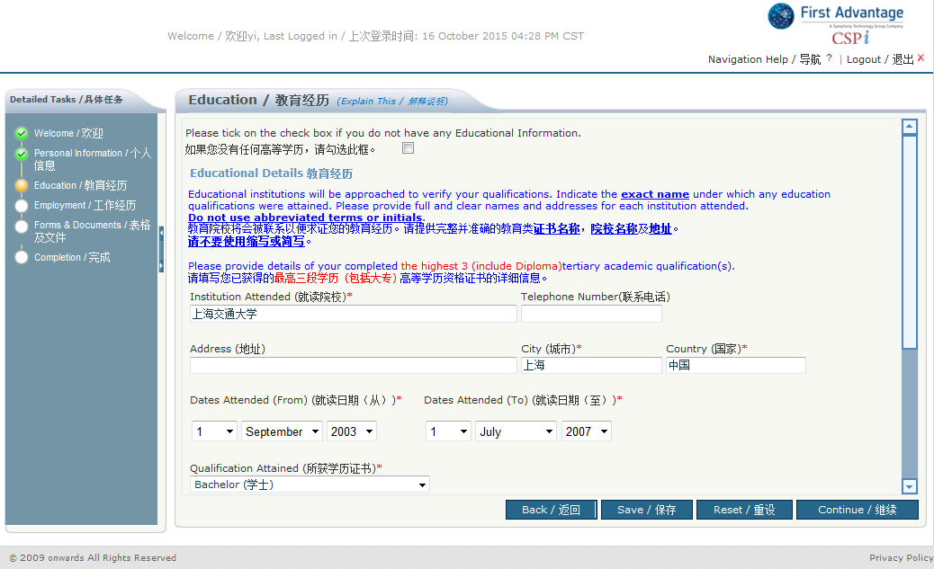

Slide 7
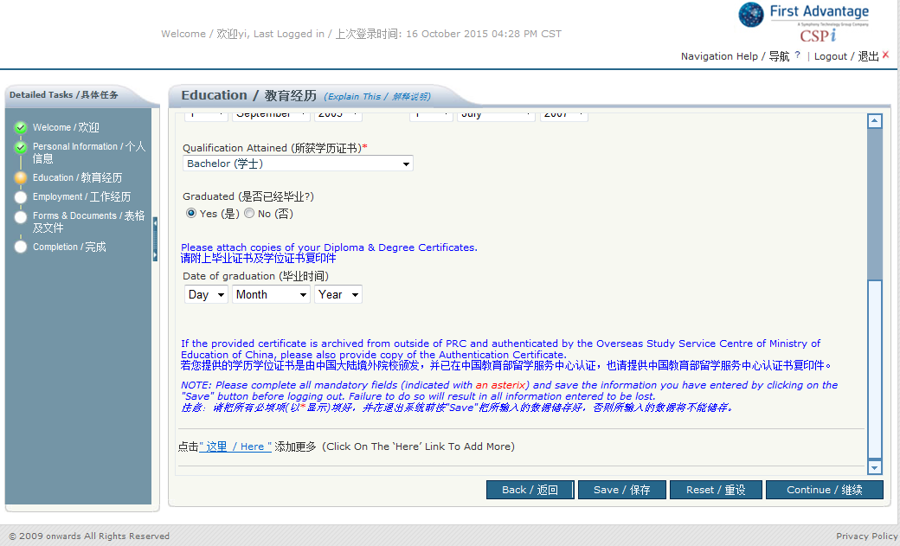
Pls click here if need add more education information.
It covers the education from associate diploma to the highest academic qualification. 最低大专（若有）起至最高学历
Once complete this part, please save first, then continue

Slide 8
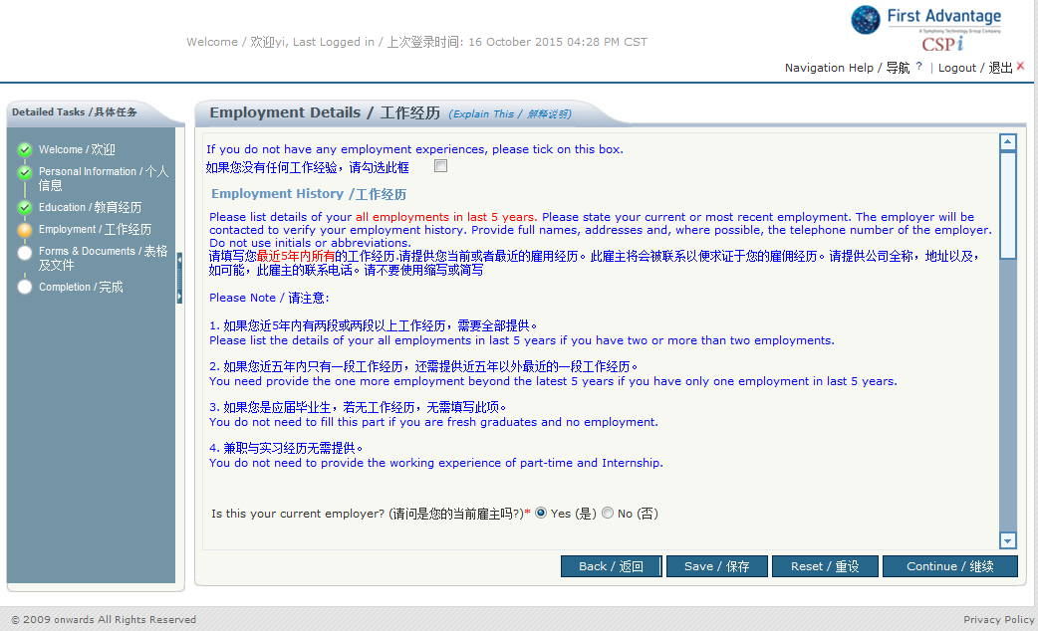
Pls start from current or most recent employment

Slide 9
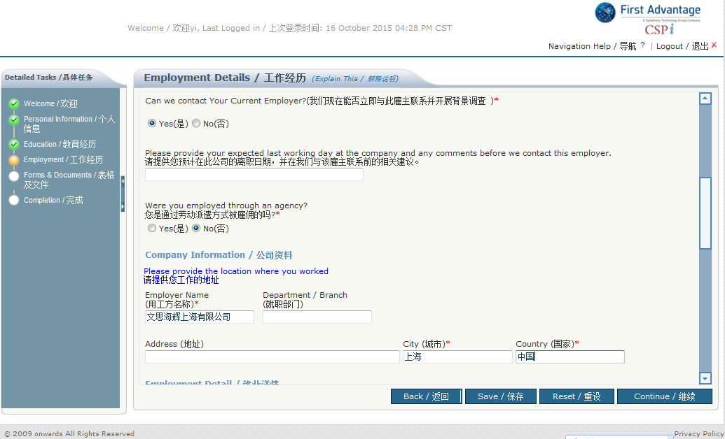

Slide 10
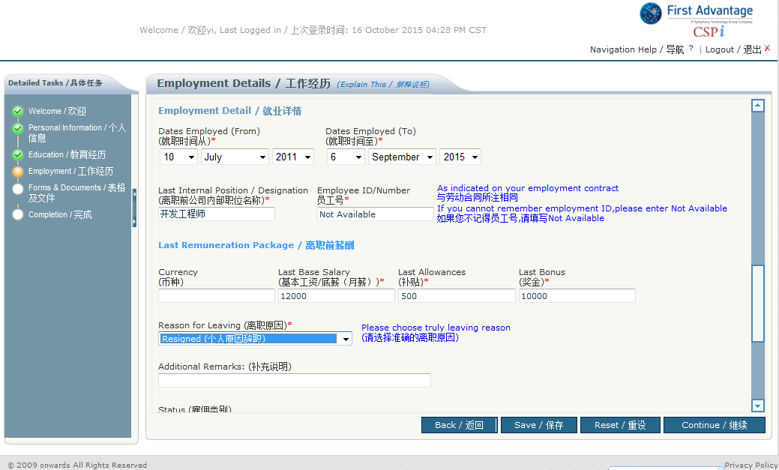

Slide 11
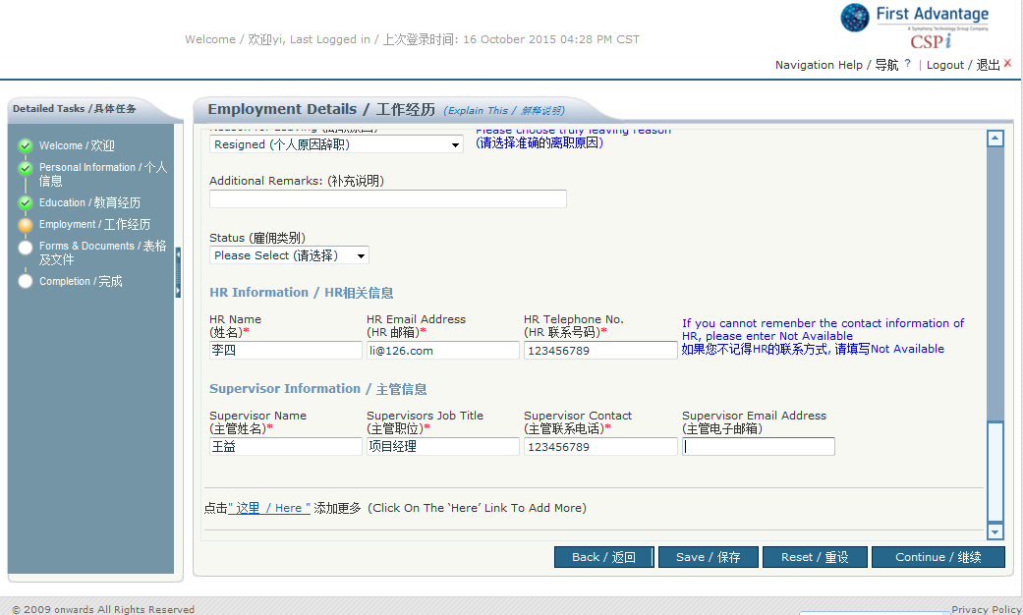
Pls click here is you need add more employment information
Pls fill last 5 years or last 2 employers, whichever is higher.

Slide 12
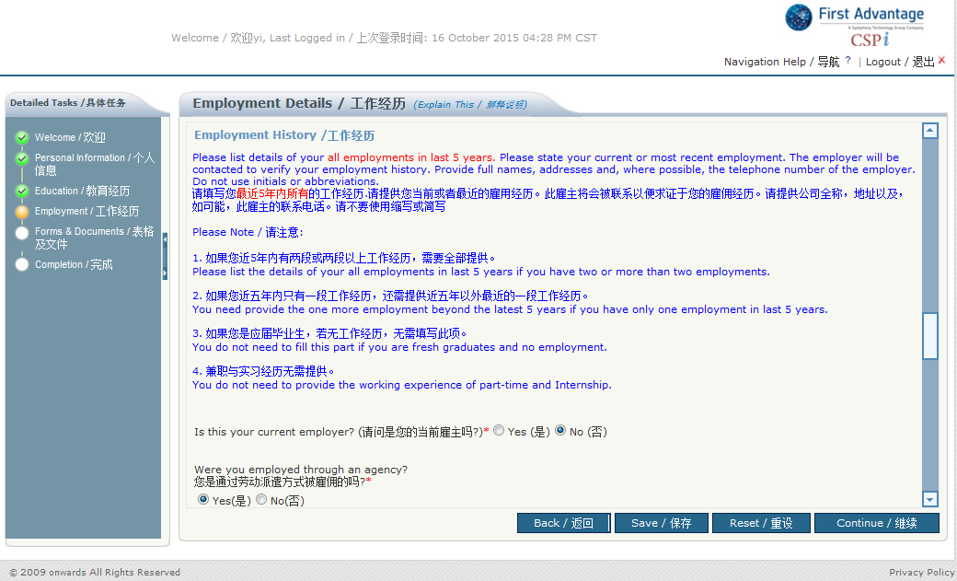

Slide 13
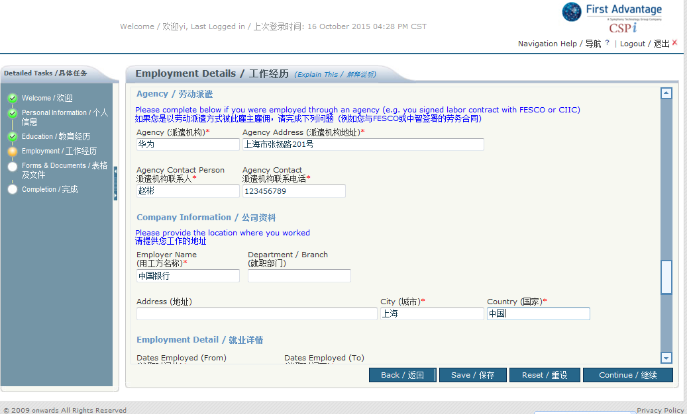

Slide 14
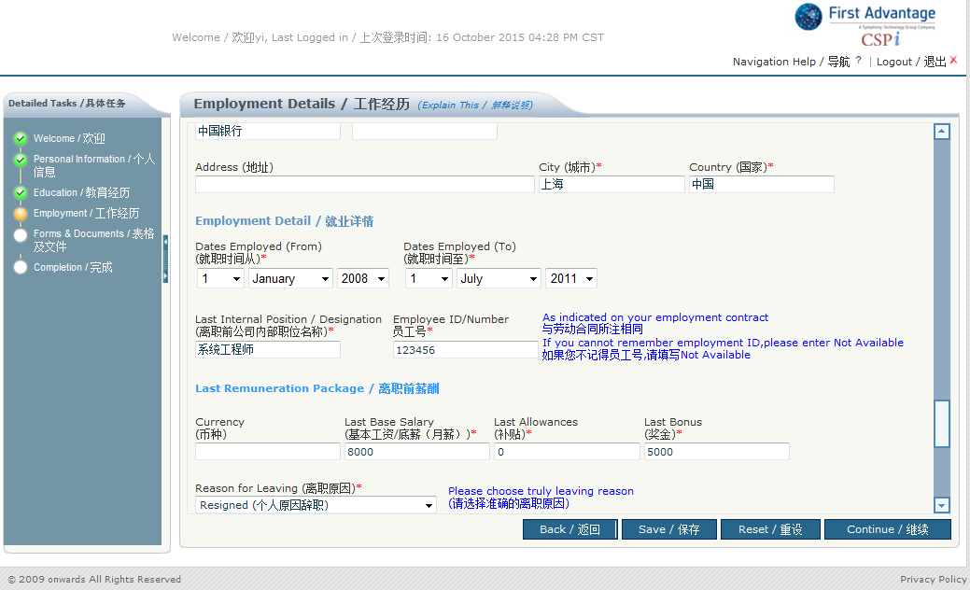

Slide 15
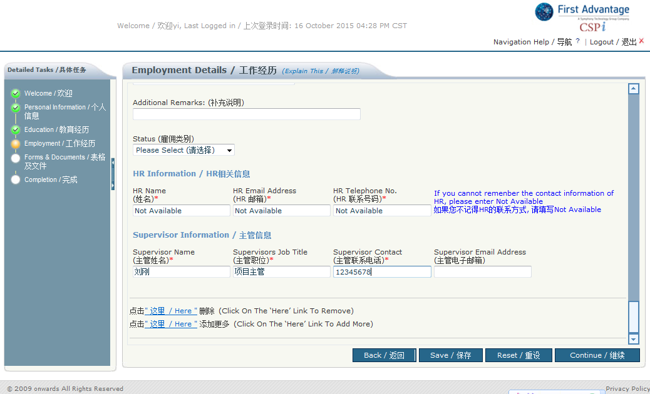
Once complete this part, pls save first, then continue

Slide 16
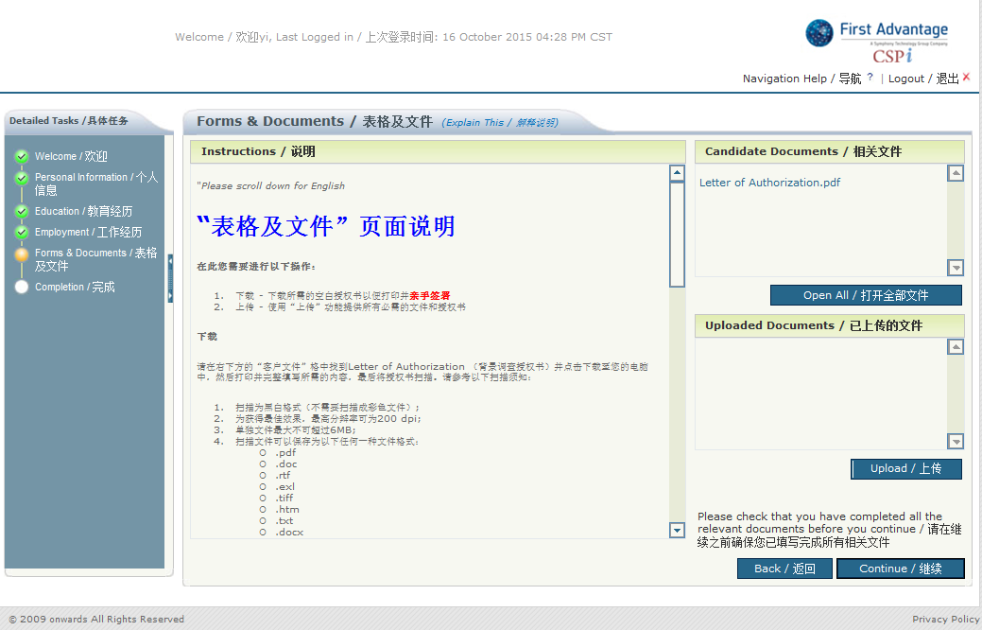
Please download letter of authorization and sign, you can also print from welcome email
Click here to upload all the required documents

Slide 17
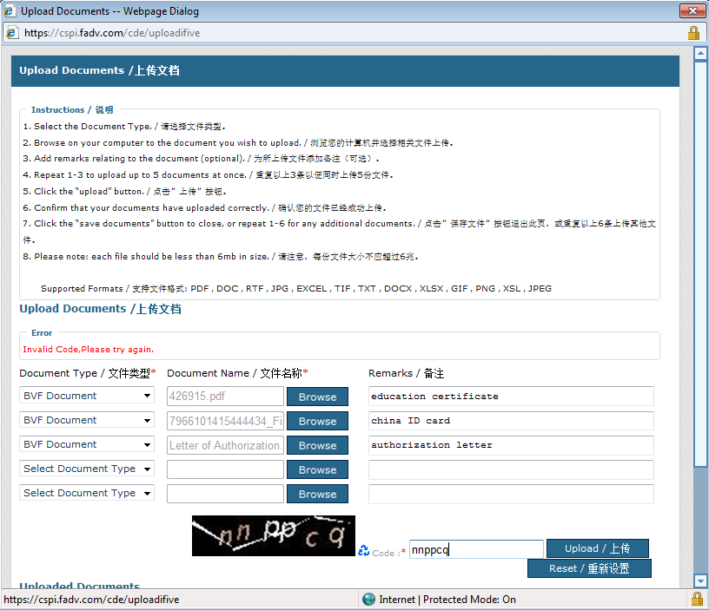
Document Type please select BVF Document, please upload PRC ID card/passport (for foreigner), education certificate and letter of authorization

Slide 18
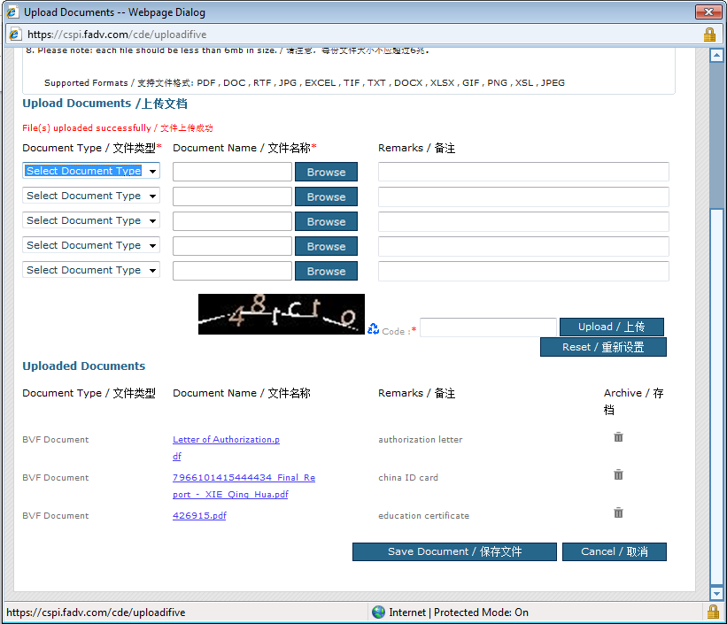
If the document you upload incorrect, you can click here to delete and upload again
Once complete upload, pls save document

Slide 19
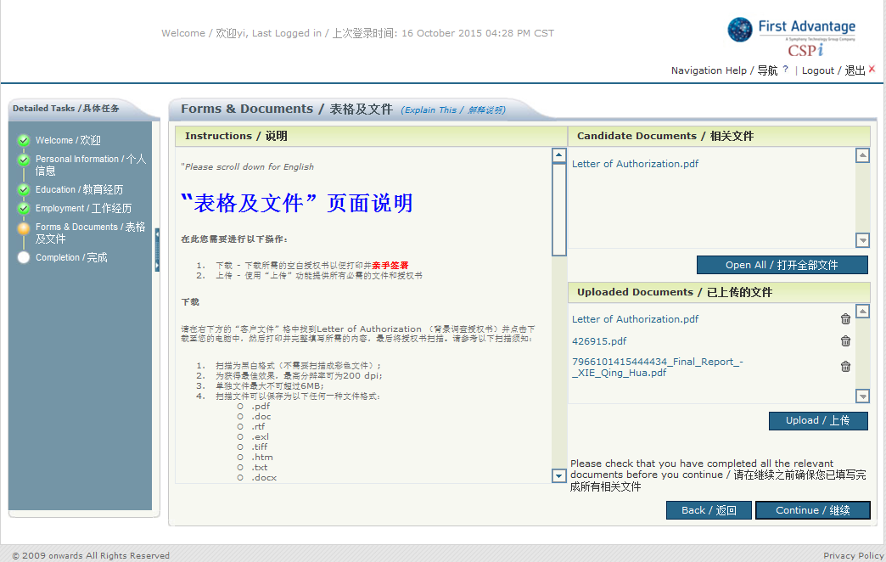
Once complete this part, please click continue

Slide 20
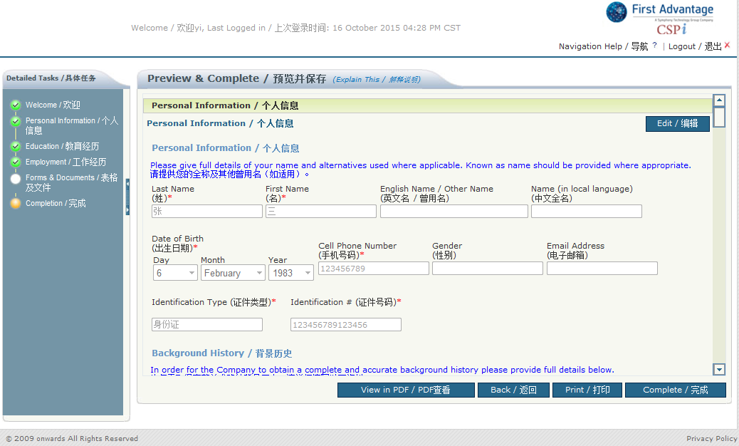
Please review all the information you provide, ensure they are correct and truth, then click complete

Slide 21
